Slide 1







HOME
ABOUT
SERVICE
CONTACT
ETHICS OF
ARTIFICIAL INTELLIGENCE
PRESENTATION

Slide 2




LOGO
HOME
ABOUT
SERVICE
CONTACT
TABLE OF CONTENTS
01.
02.
03.
INTRODUCTION
OUR PROJECTS
ABOUT US
Elaborate on what you want to discuss.
Elaborate on what you want to discuss.
Elaborate on what you want to discuss.

Slide 3

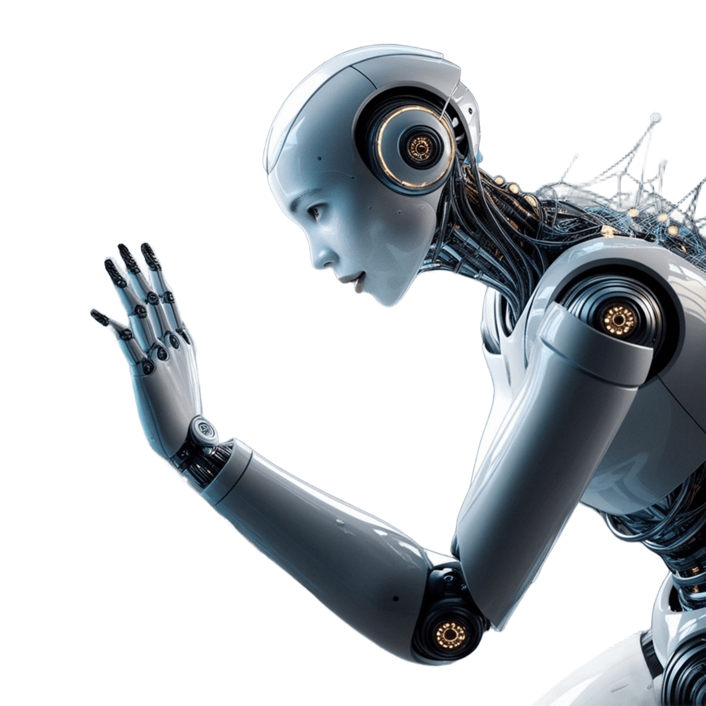



LOGO
HOME
ABOUT
SERVICE
CONTACT
INTRODUCTION
Welcome to a place where stories come alive and dreams take flight.To the world of creative writing, where imagination knows no bounds, and every word holds the power to transport you to new realms.
Whether you're an aspiring author, a seasoned novelist, or someone who simply loves to weave tales, this journey promises to be an exhilarating one. Here, we will explore the art of storytelling, delve into the intricacies of character development, and unravel the secrets behind crafting compelling plots.

Slide 4



LOGO
HOME
ABOUT
SERVICE
CONTACT
WELCOME TO PRESENTATION
I'm Rain, and I'll be sharing with you my beautiful ideas. Follow me at @reallygreatsite to learn more.

Slide 5






LOGO
HOME
ABOUT
SERVICE
CONTACT
HISTORICAL BACKGROUND OF AI AND ETHICS
EVOLUTION OF AI
EARLY ETHICAL CONCERNS
KEY MILESTONES IN AI ETHICS
A brief history of AI development from its inception to the present day.
Discuss the initial ethical
debates surrounding AI, including fears expectations.
Highlight important events or cases that brought AI ethics to the forefront.

Slide 6






LOGO
HOME
ABOUT
SERVICE
CONTACT
KEY ETHICAL ISSUES IN AI
ACCOUNTABILITY AND RESPONSIBILITY
BIAS AND FAIRNESS
Explore how AI systems can perpetuate or even amplify existing biases.
Who is accountable when AI systems cause harm?
PRIVACY AND SURVEILLANCE
TRANSPARENCY AND EXPLAINABILITY
Discuss the ethical implications of AI in data collection and surveillance.
The importance of making AI decisions understandable and transparent to users.

Slide 7
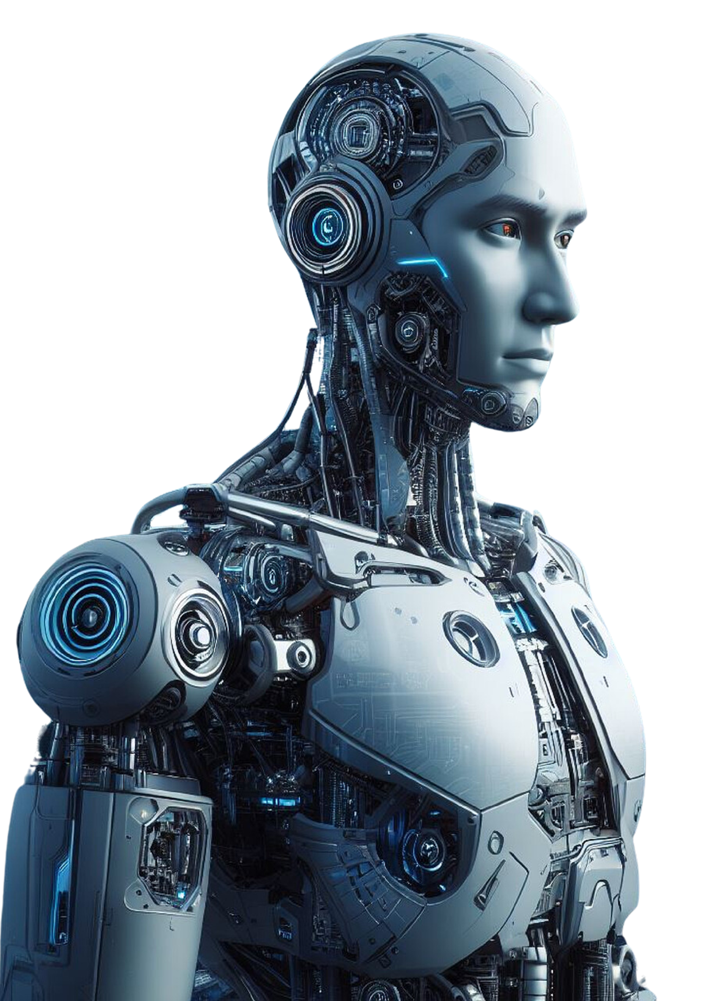


LOGO
HOME
ABOUT
SERVICE
CONTACT
OUR PROJECTS
At our core, we are driven by a passion for innovation and a commitment to excellence in all that we do. Our projects embody our dedication to creating impactful solutions that make a difference in the world.
From groundbreaking technological advancements to community-driven initiatives, each project we undertake is a testament to our belief in the power of creativity and collaboration.We strive to push the boundaries of what is possible, constantly seeking new ways to address challenges and improve lives.

Slide 8
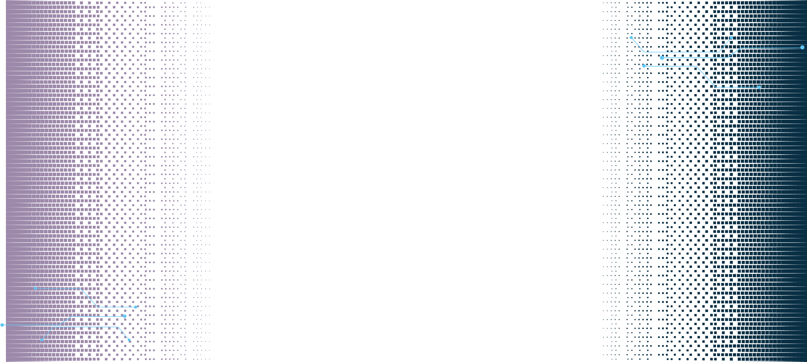







LOGO
HOME
ABOUT
SERVICE
CONTACT
DEONTOLOGICAL ETHICS
Applying duty-based ethics to AI: adherence to rules and principles.
ETHICAL FRAMEWORKS AND APPROACHES
UTILITARIAN ETHICS
Evaluating AI based on outcomes: maximizing benefits and minimizing harm.
VIRTUE ETHICS
Focusing on the moral character of those who create and use AI systems.

Slide 9


LOGO
HOME
ABOUT
SERVICE
CONTACT
STRATEGIES FOR ETHICAL AI DEVELOPMENT
INCORPORATING ETHICS INTO AI DESIGN
REGULATORY AND POLICY APPROACHES
Methods for integrating ethical considerations into the AI development process.
The role of government and international bodies in regulating AI ethics.
CORPORATE RESPONSIBILITY AI
PUBLIC ENGAGEMENT AND EDUCATION
The importance of corporate ethics programs and AI governance.
Encouraging public discourse and understanding of AI ethics.

Slide 10
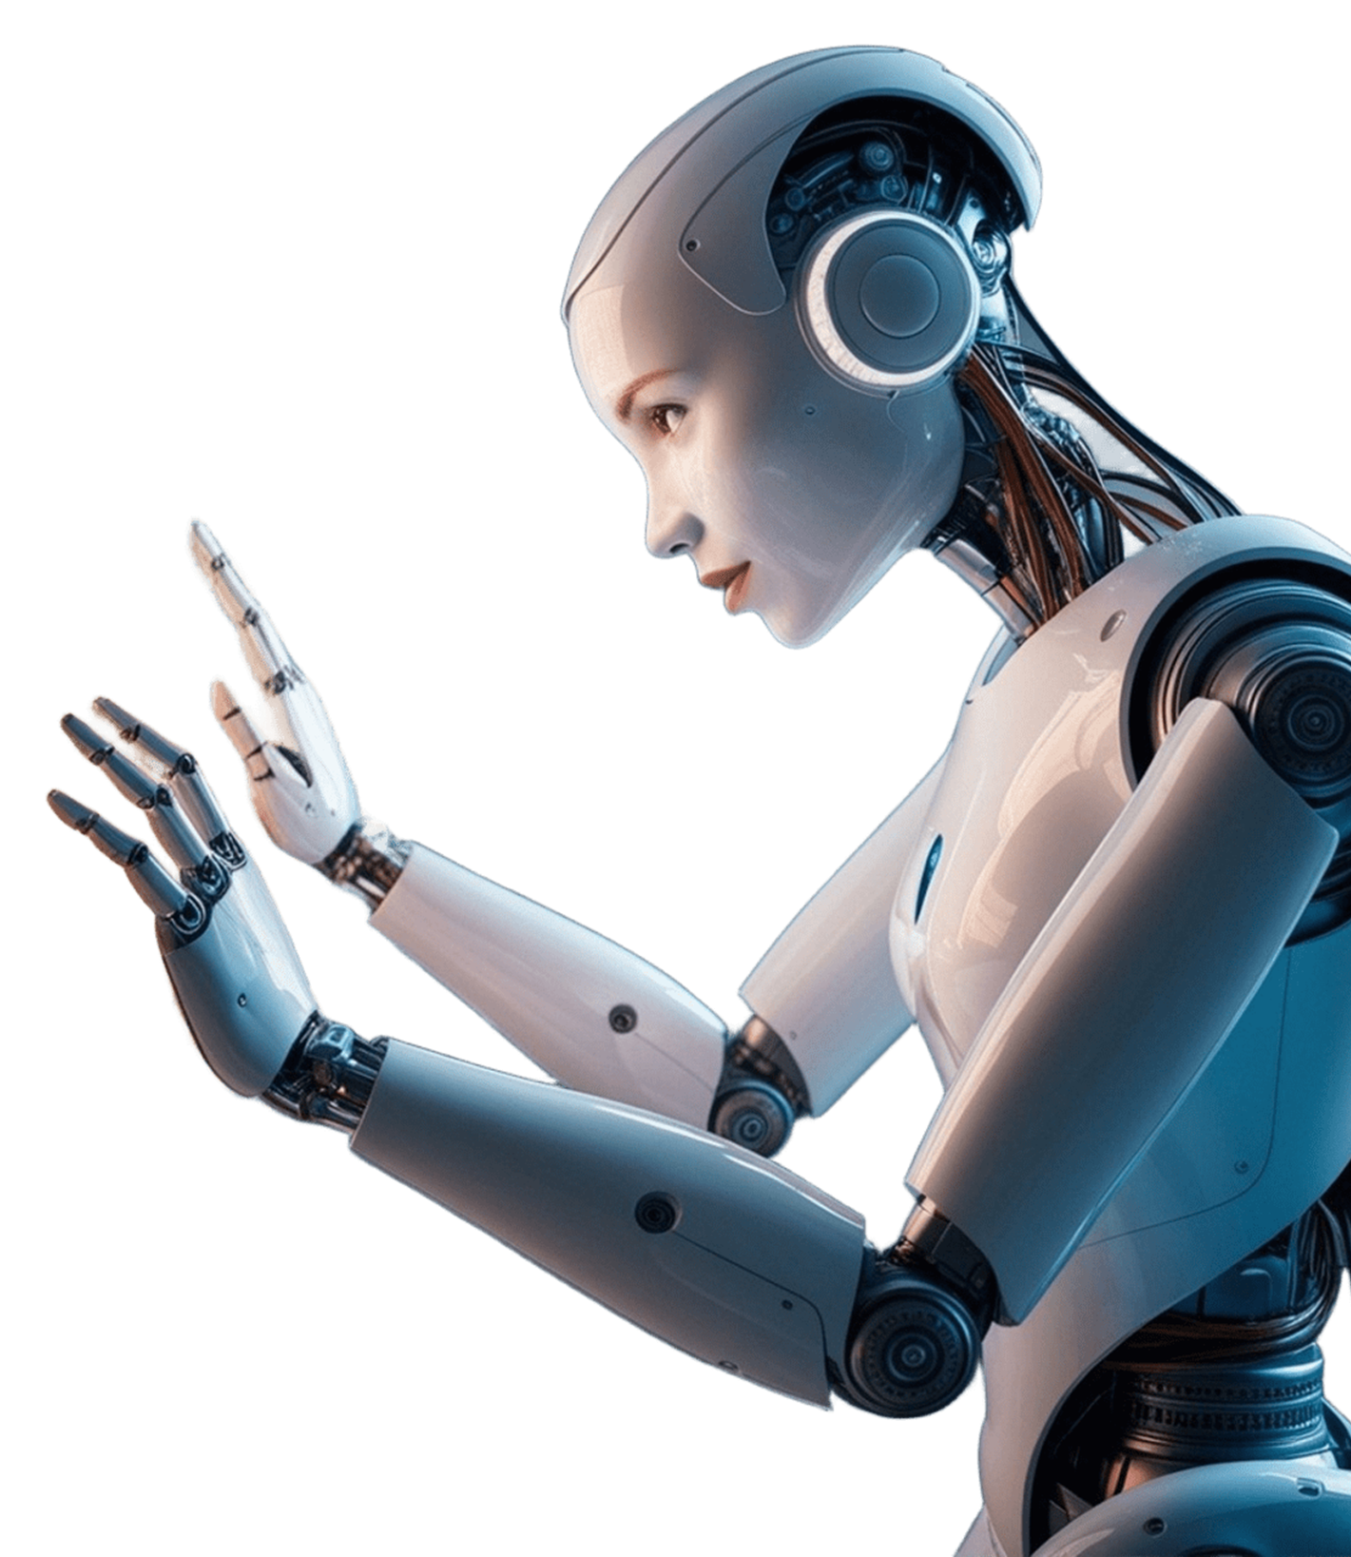



LOGO
HOME
ABOUT
SERVICE
CONTACT
FUTURE DIRECTIONS IN AI ETHICS
AI AND HUMAN RIGHTS
How AI might challenge or support fundamental human rights.
AI IN GLOBAL GOVERNANCE
The role of international cooperation in establishing AI ethics standards.

Slide 11

LOGO
HOME
ABOUT
SERVICE
CONTACT
CASE STUDIES
CASE STUDY 1:
AI IN HEALTHCARE
CASE STUDY 2:
AI IN AUTONOMOUS VEHICLES
The integration of Artificial Intelligence (AI) into healthcare has brought about a transformative shift in how medical diagnosis, treatment, and patient care are approached. However, while AI offers numerous benefits, its use in these critical areas also raises significant ethical concerns that must be carefully considered to ensure that technology serves the best interests of all patients.
Autonomous vehicles (AVs) represent a groundbreaking innovation in transportation, promising to reduce traffic accidents, improve road safety, and revolutionize mobility. However, the deployment of AVs also introduces profound ethical dilemmas, particularly in scenarios where the vehicle must make decisions involving life-and-death situations. Unlike human drivers.

Slide 12





LOGO
HOME
ABOUT
SERVICE
CONTACT
TESTIMONIALS
CLIENT NAME
CLIENT NAME
CLIENT NAME
Elaborate on what you want to discuss.
Elaborate on what you want to discuss.
Elaborate on what you want to discuss.

Slide 13
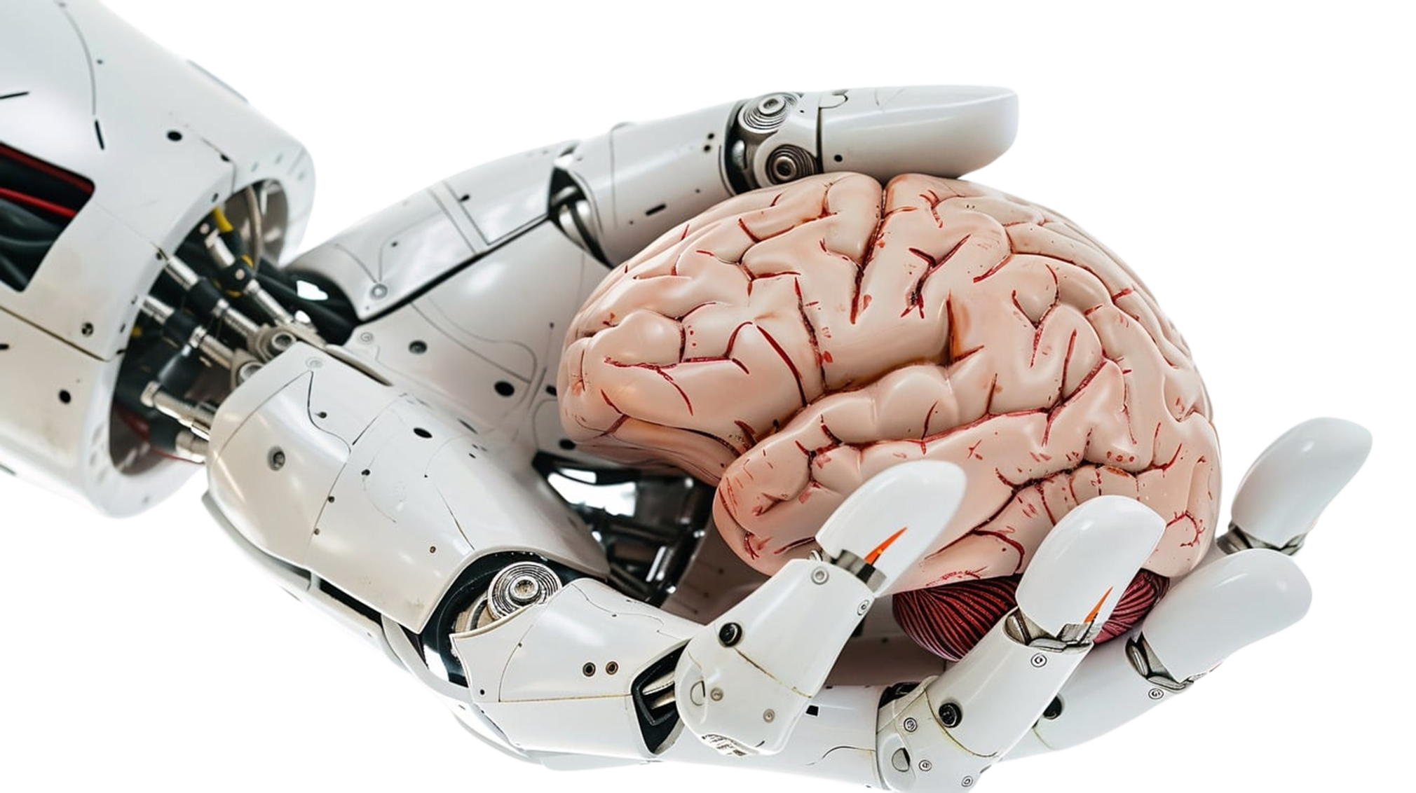

LOGO
HOME
ABOUT
SERVICE
CONTACT
ABOUT US
We are a team of passionate individuals dedicated to providing exceptional service and creating memorable experiences for our clients. With a commitment to excellence and a focus on innovation, we strive to exceed expectations and deliver top-notch results. Our goal is to build lasting relationships with our clients and make a positive impact in everything we do. Thank you for choosing us to be a part of your journey.

Slide 14








LOGO
HOME
ABOUT
SERVICE
CONTACT
TRANSPARENCY
Elaborate on what you want to discuss.
RESPECT FOR HUMAN VALUES
PRIVACY
Elaborate on what you want to discuss.
Elaborate on what you want to discuss.
ETHICS IN AI
ACCOUNTABILITY
FAIRNESS
Elaborate on what you want to discuss.
Elaborate on what you want to discuss.
SAFETY
Elaborate on what you want to discuss.

Slide 15




LOGO
HOME
ABOUT
SERVICE
CONTACT
OUR HISTORY
ADD A MAIN POINT
ADD A MAIN POINT
ADD A MAIN POINT
Elaborate on what you want to discuss.
Elaborate on what you want to discuss.
Elaborate on what you want to discuss.

Slide 16

A PICTURE IS WORTH A THOUSAND WORDS

Slide 17


LOGO
HOME
ABOUT
SERVICE
CONTACT
WRITE AN ORIGINAL STATEMENT OR INSPIRING QUOTE
— Include a credit, citation, or supporting message

Slide 18





LOGO
HOME
ABOUT
SERVICE
CONTACT
CONTACT US
123 Anywhere St., Any City,ST 12345
123-456-7890
hello@reallygreatsite.com
@reallygreatsite
reallygreatsite.com

Slide 19

RESOURCE
PAGE
Use these design resources in your Canva Presentation.
You can find these fonts online too. Happy designing!
Don't forget to delete this page before presenting.
This presentation template uses the following free fonts:
Titles: Oswald
Headers: Oswald
Body Copy: Montserrat

Slide 20


CREDITS
This presentation template is free for everyone to use thanks to the following:
SlidesCarnival for the presentation template
Pexels for the photos
Happy designing!

